Slide 1
9th Grade Counseling Orientation
NAI - 2023-2024

Slide 2
NAI Counseling Department
Where is the Counseling office?
The Counseling Office is located at the top of the stairs, from the Cafeteria, in A hall.
How do I know who my counselor is?
Students are assigned to counselors by the first letter of their last name.

Slide 3
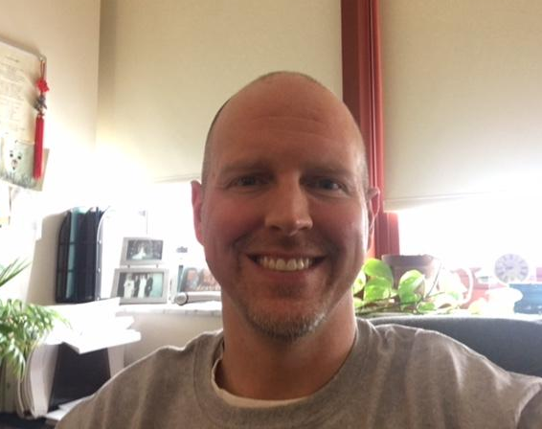
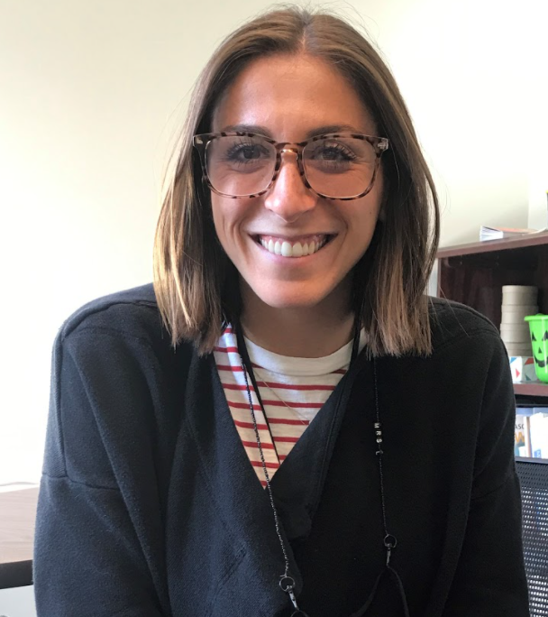
Meet the NAI Counselors
Mr. Kiggins, A - Dn bkiggins@northallegheny.org
Mrs. Lewis, Do - J
mlewis@northallegheny.org
Notes:
Maddie

Slide 4
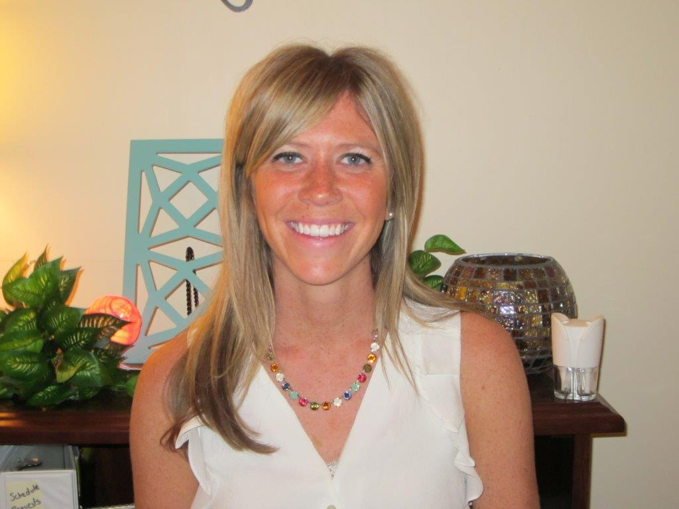
Meet the NAI Counselors
Mrs. Mayhew, K - M
mmayhew@northallegheny.org
Mr. Butler, N - Sh
mbutler@northallegheny.org
Notes:
Maddie

Slide 5
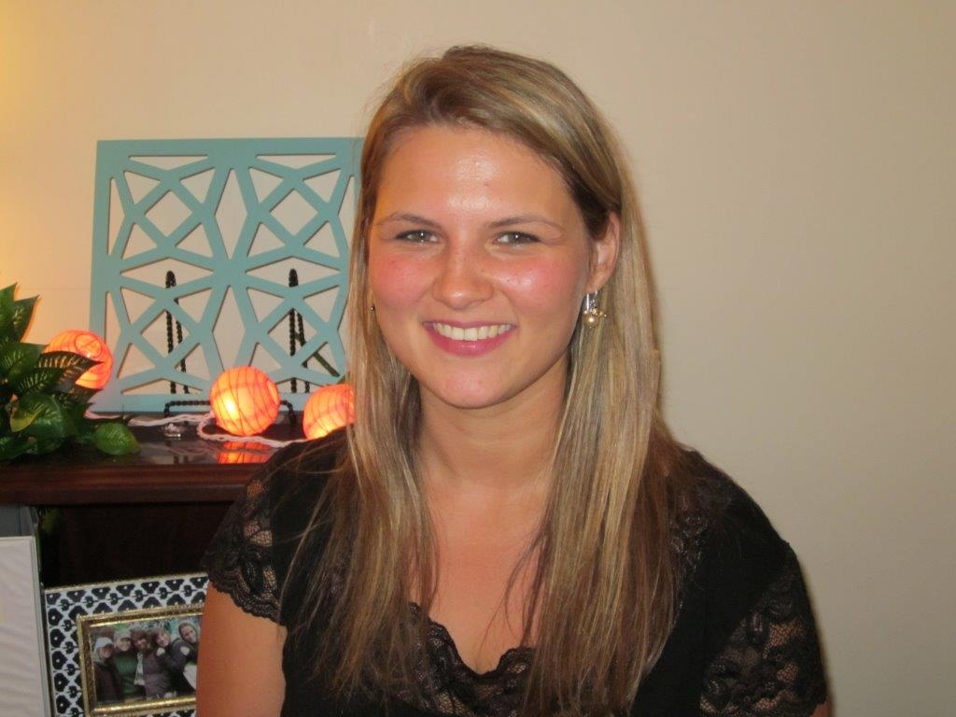
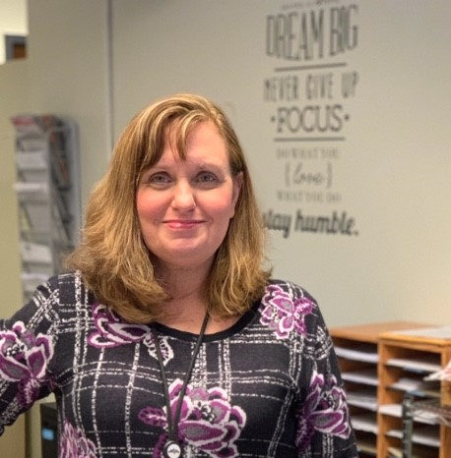
Meet the NAI Counselors
Mrs. Liebenguth, Si - Z
rliebenguth@northallegheny.org
Ms. McLeod
Counseling Department
Secretary
412-369-5464
Notes:
Maddie

Slide 6
How To Meet With Your Counselor
If you need to speak with your counselor, you may stop by the counseling office or e-mail them to set up a time to meet in person.
Mr. Kiggins - bkiggins@northallegheny.org
Mrs. Lewis - mlewis@northallegheny.org
Mrs. Mayhew - mmayhew@northallegheny.org
Mr. Butler - mbutler@northallegheny.org
Mrs. Liebenguth - rliebenguth@northallegheny.org

Slide 7
NAI 9th Grade Course Sequence
Required
English 1.0 credit
American History 0.5 credit
European History 0.5 credit
Math 1.0 credit
Science 1.0 credit
Health & PE 0.5 credit
Wellness 0.5 credit
Total 5.0 credits
Elective Courses: up to 3.0 credits (must schedule at least 2.0 credits)
**Students should not be in Euro and American History in the same semester. Please see your counselor if you have them the same semester.
**Students must take a minimum of 7 credits and a maximum of 8 credits.

Slide 8
Other Important Topics
Transcripts
NCAA
North Allegheny E-mail
Power School STUDENT Portal

Slide 9
NEED HELP?
TEACHERS! TEACHERS! TEACHERS!
Subject area tutoring
Northland Library Online Tutoring
Connect with your counselor about other supports

Slide 10
Personal Counseling

Slide 11
Group Counseling
Coping with Loss
Coping with Changes in your Family/Stepfamily
Concerned Person’s Group
Handling Stress
Improving Personal Relationships
Why do I Feel Sad? What Can I Do?
Eating Concerns (Anorexia, Bulimia)
Insight Into Chemical Use
Aftercare for Recovery
Coping with Anger
Quit Smoking
New Student Group
Boys/Girls Group
Coping with Illness in Your Family
***if you are interested in any of these possible groups, please e-mail your counselor***

Slide 12
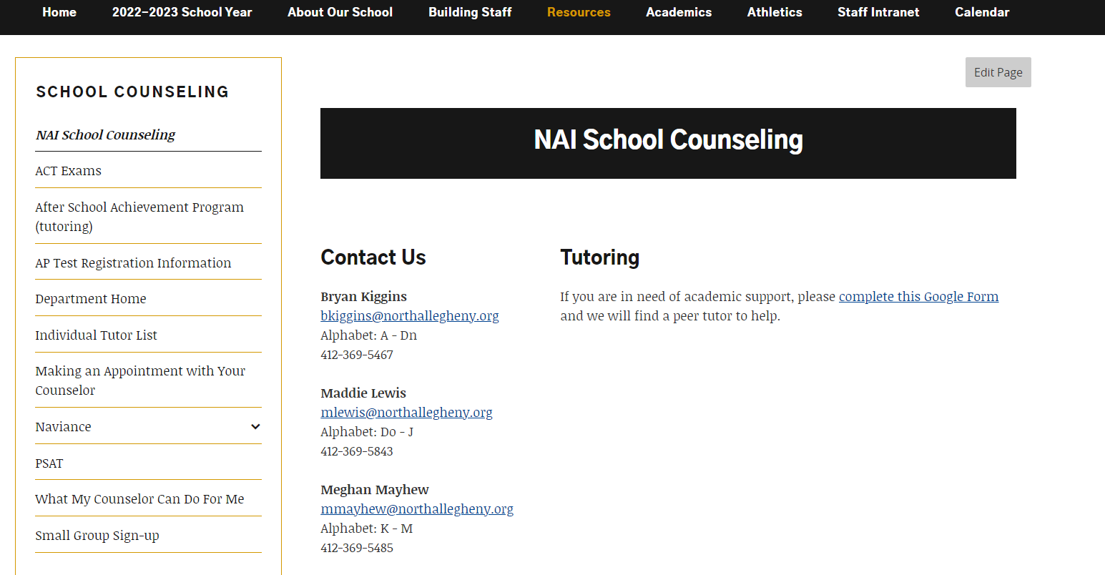
SSmall Group Google Link

Slide 13
Welcome to Naviance
Naviance is a web-based resource for students and parents that encourages and supports post high school career and college planning.
Family Connection is specific to our school.
Family Connection is linked with Naviance Succeed, a service that is used in School Counseling.

Slide 14
How Can I Use It?
Career Planning
Learning Style Inventory, Interest Inventory, Personality Inventory, Resume Building
College Planning
College Search, Application Process, College Major Exploration, Scholarship/Financial Aid Resources
Success Planning
Personalized Goals and Tasks, Journal Entries, Student Planner

Slide 15
Getting Started - Naviance
***Login to Naviance through your TIGER ID portal***

Slide 16
Road Trip Nation
Once you have logged in, click on “Explore Roadtrip Nation Videos” under “Careers.”

Slide 17
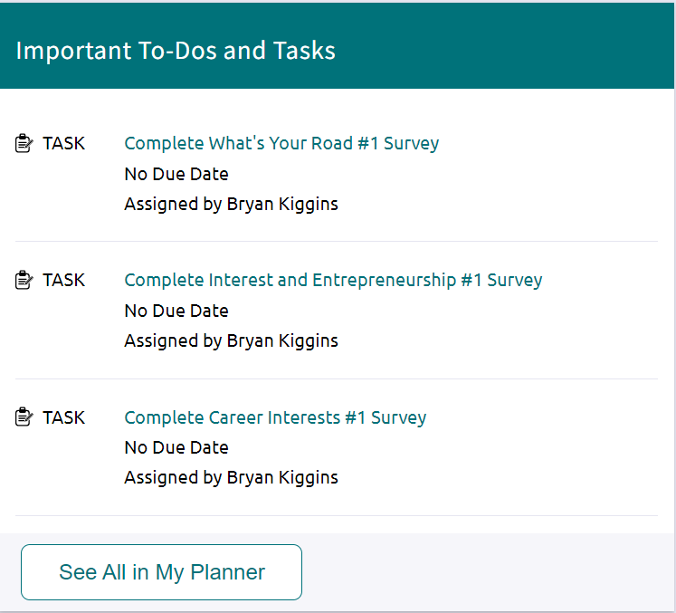
Career Interests: Under the "Career" tab, click on "Explore Road Trip Nation Videos." Scroll down, click on "By Interests" box, and choose a circle that identifies with your post-secondary interests. Choose one leader of your interest to research and complete this survey.
Interests and Entrepreneurship: Go to the "Career" tab and click on "Explore Road Trip Nation Videos". Scroll down and click on "By Interests" box. Find the Entrepreneurship circle and click on it. Then choose a leader to research. Once done, please complete this survey.
What’s Your Road: Under the "Career" tab, click
on "Explore Road Trip Nation Videos." Click on the pink
square titled "Find Your Road." Then click on "Define
Your Road," and complete the road map. Once done,
then you will fill out this survey.

Slide 18
Thank You!
NAI - 2023-2024

